Slide 1
TB CALCULATION
Spreadsheet Documentation

Slide 2
Definitions
WHO region: designated regions provided by the World Health Organization¹
DALY: Disability-Adjusted Life Years (D)
Years of life taken by disease from population if it was in a healthy state free from disease
Treatment Coverage (θ):
Ratio between number of people receiving treatment to the estimated number of people needing treatment
Efficacy (e):
Percentage of population receiving treatment that were actually cured
Data generated from WHO, UNAID database
¹http://www.who.int/neglected_diseases/preventive_chemotherapy/sch/en/

Slide 3
Tuberculosis by Countries
Our current TB model investigates the impact of drugs on three patient groups: drug-susceptible TB (DS-TB), multidrug resistant TB (MDR-TB), and extensively drug-resistant TB (XDR-TB). The model also makes a distinction between the drug impact of DS-TB patients with HIV and without.
All TB Incident Cases
DS-TB
HIV+
HIV-
MDR-TB
XDR-TB

Slide 4
Impact Formula
D * e * Θ
1 - e * Θ
I =
Where:
D = DALYs
e = Efficacy
Θ = Treatment Coverage

Slide 5
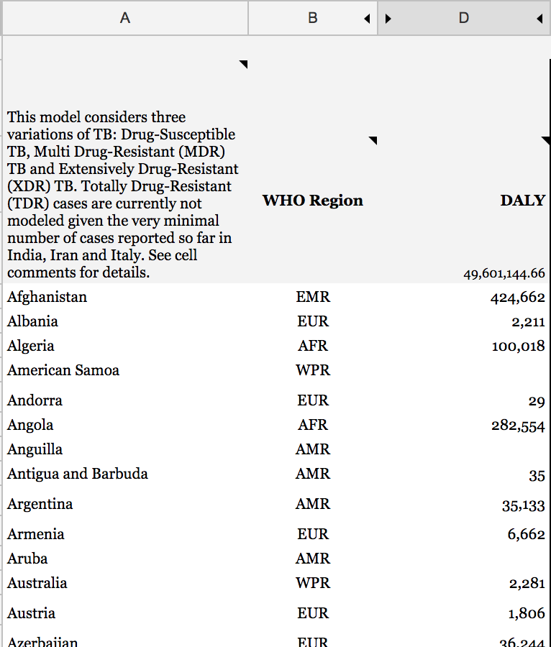
Country Data
Column A: Country
Column B: Countries sorted by WHO Region
Column D: DALYs

Slide 6
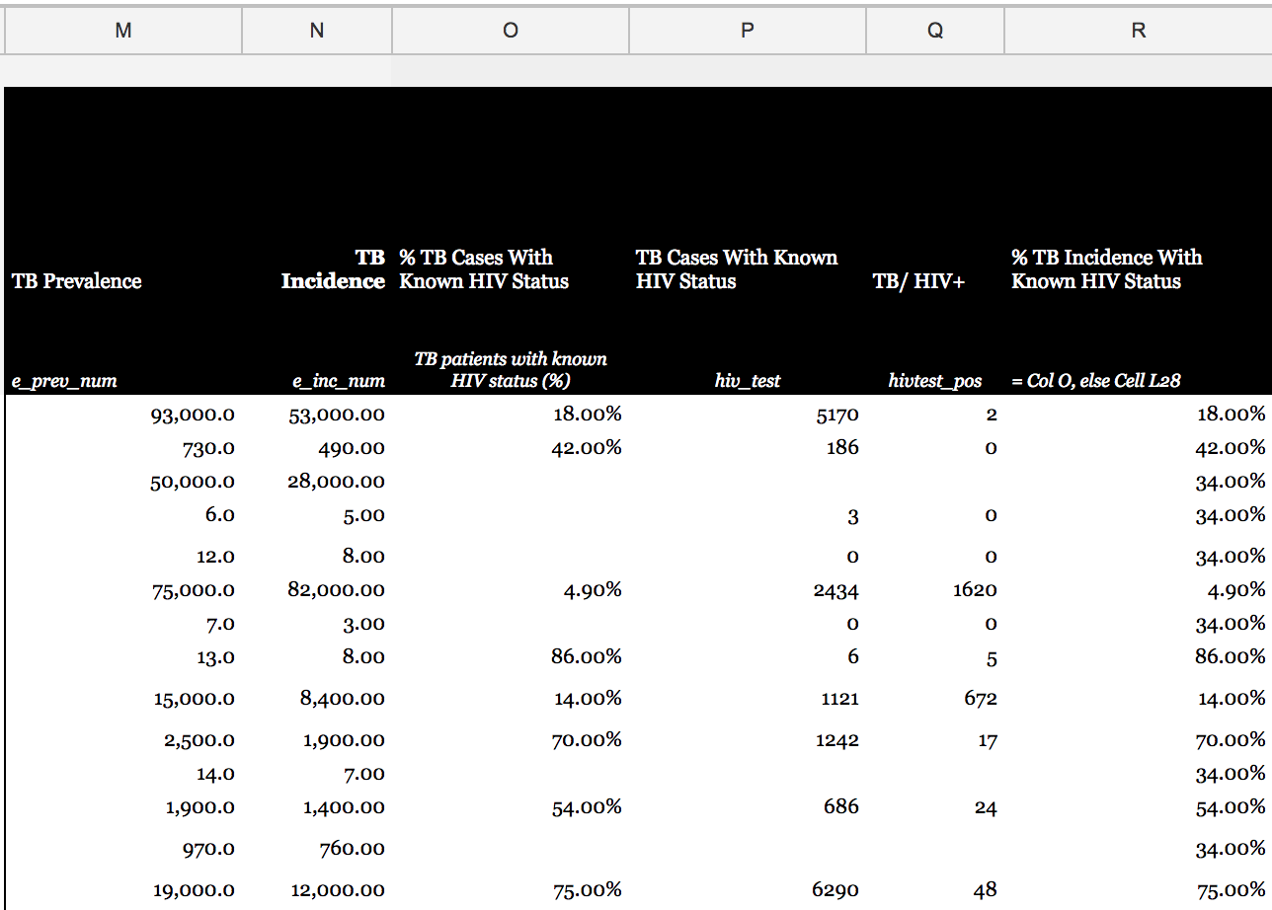
Prevalence and Incidence
Column M: Total TB prevalence
Column N: Total TB incidence
Column O: % of cases with known status
Column P: # of cases with known status
Column Q: New and retreated cases recorded as TB/HIV+
Column R: % incidence with known HIV status

Slide 7
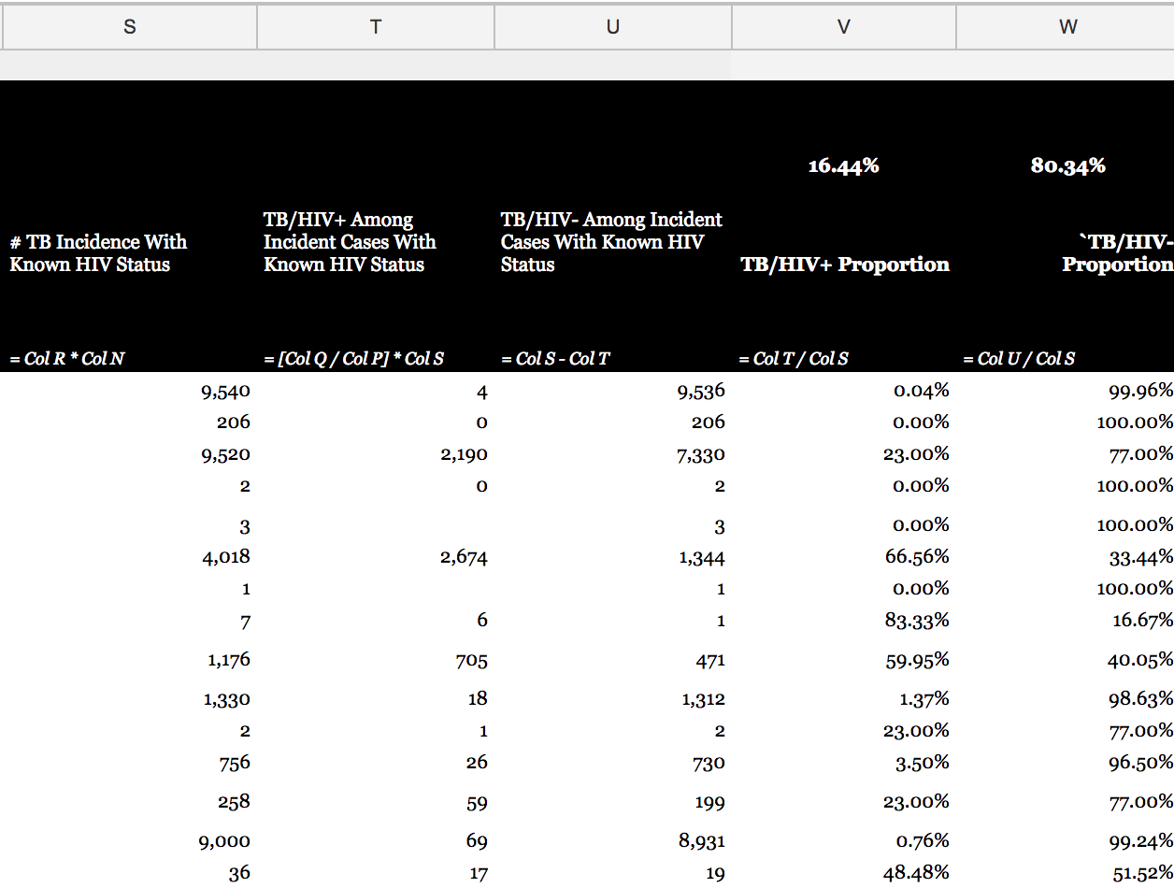
Prevalence and Incidence
Column S: # incidence with known HIV status
Column T: TB/HIV+ Among Incident Cases With Known HIV Status
Column U: TB/HIV- Among Incident Cases With Known HIV Status
Column V: Col T/Col S
Column W: Col U/Col S

Slide 8
DS-TB

Slide 9
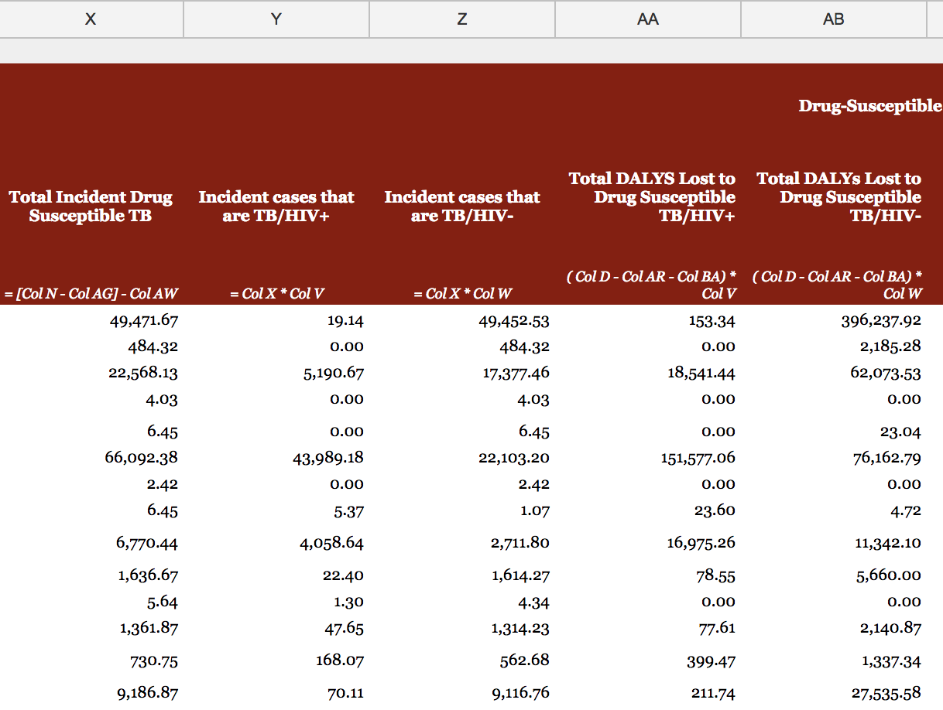
Incidence and DALYs
Column X: Col N-Col AG-Col AW
Column Y: Col X*Col V
Column Z: Col x*Col W
Column AA: (Col D-Col AR-Col BA)*Col V
Column AB: (Col D-Col AR-Col BA)*Col W

Slide 10
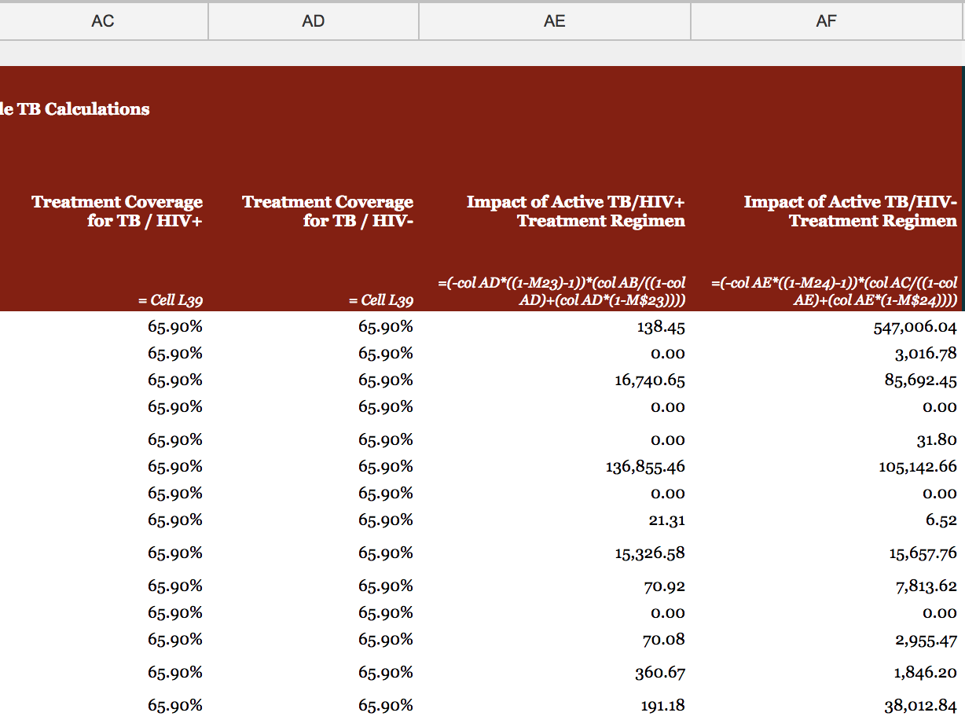
Coverage and Impact
Column AC: Treatment coverage
Column AD: Treatment coverage
Column AE: Efficacy of DS-TB treatment can be found in the Assumptions section
Column AF: Efficacy of DS-TB treatment can be found in the Assumptions section

Slide 11
MDR-TB

Slide 12
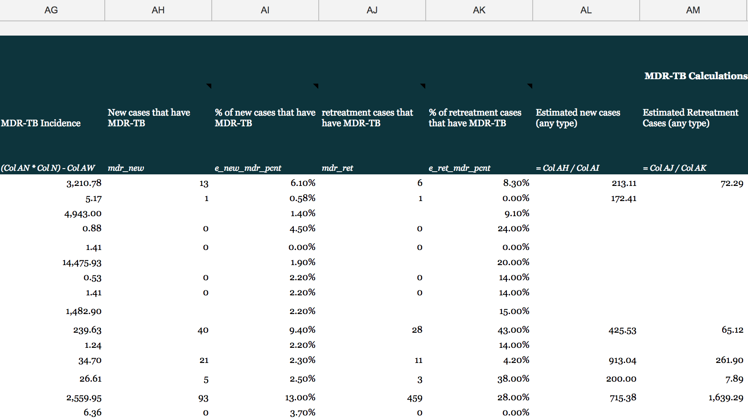
MDR-TB Case Type
Column AG: Col AN*Col N-Col AW
Column AH: New MDR-TB cases
Column AI: % of new MDR-TB cases
Column AJ: Retreated MDR-TB cases
Column AK: % of Retreated MDR-TB cases
Column AL: Col AH/Col AI
Column AM: Col AJ/Col AK

Slide 13
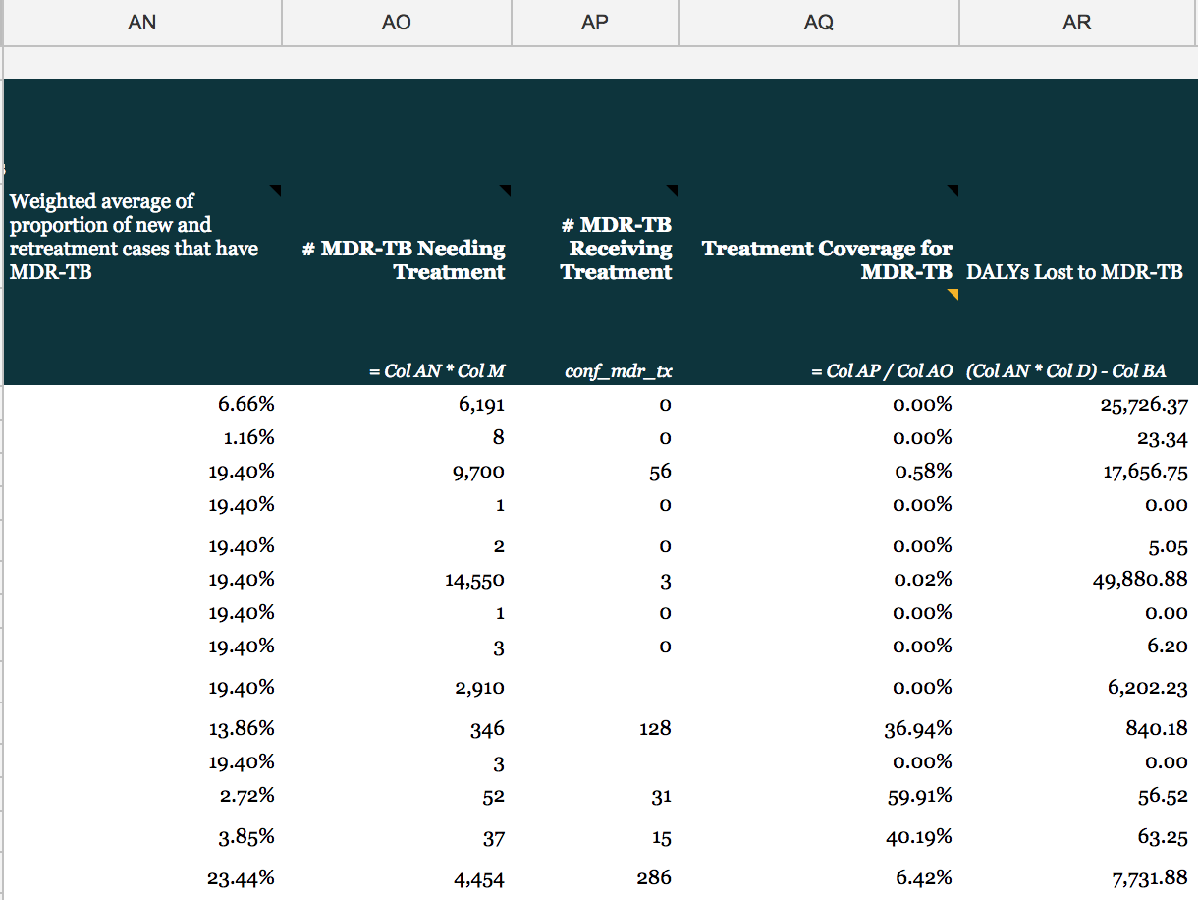
Treatment Coverage
Column AN: Percentage of new and retreated TB cases that are classified as MDR-TB
Column AO: Col AN*Col M
Column AP: Reported # of people receiving treatment for MDR-TB
Column AQ: Col AP/Col AO
Column AR: (Col AN*Col D)-Col BA

Slide 14
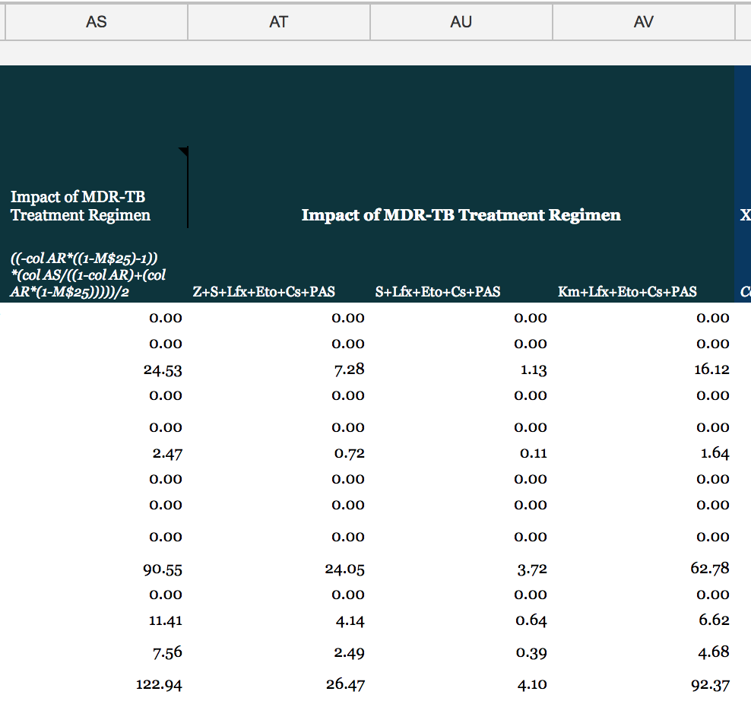
MDR-TB Impact
Column AS: Divides by two because the average length of MDR-TB treatment is two years
Column AT: Impact * Col BR
Column AU: Impact * Col BS
Column AV: Impact * Col BT

Slide 15
XDR-TB

Slide 16
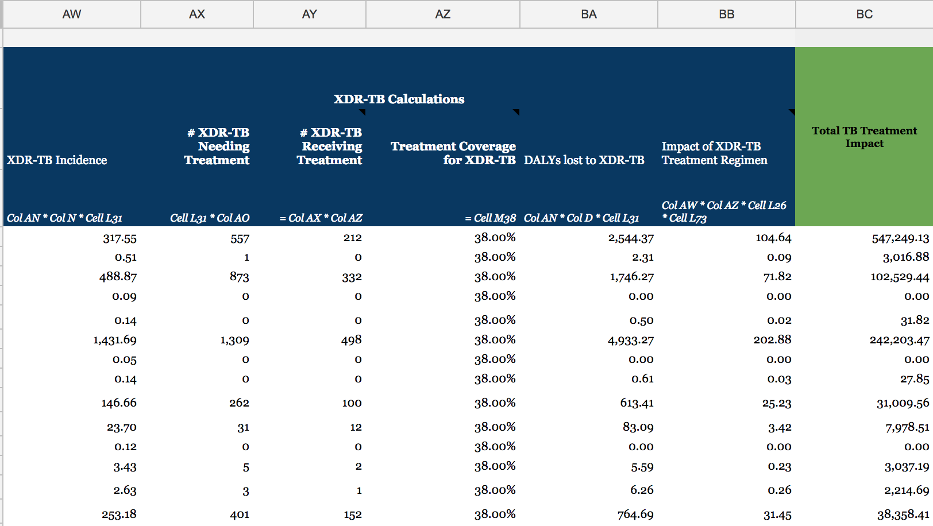
Calculation
Column AW: Col AN*Col N*L31
Column AX: L31*Col AO
Column AY: Col AX*Col AZ
Column AZ: Treatment coverage
Column BA: Col AN*Col D*L31
Column BB: Divides by two because the average length of XDR-TB is two
Column BC: Sums impact of all types of TB

Slide 17
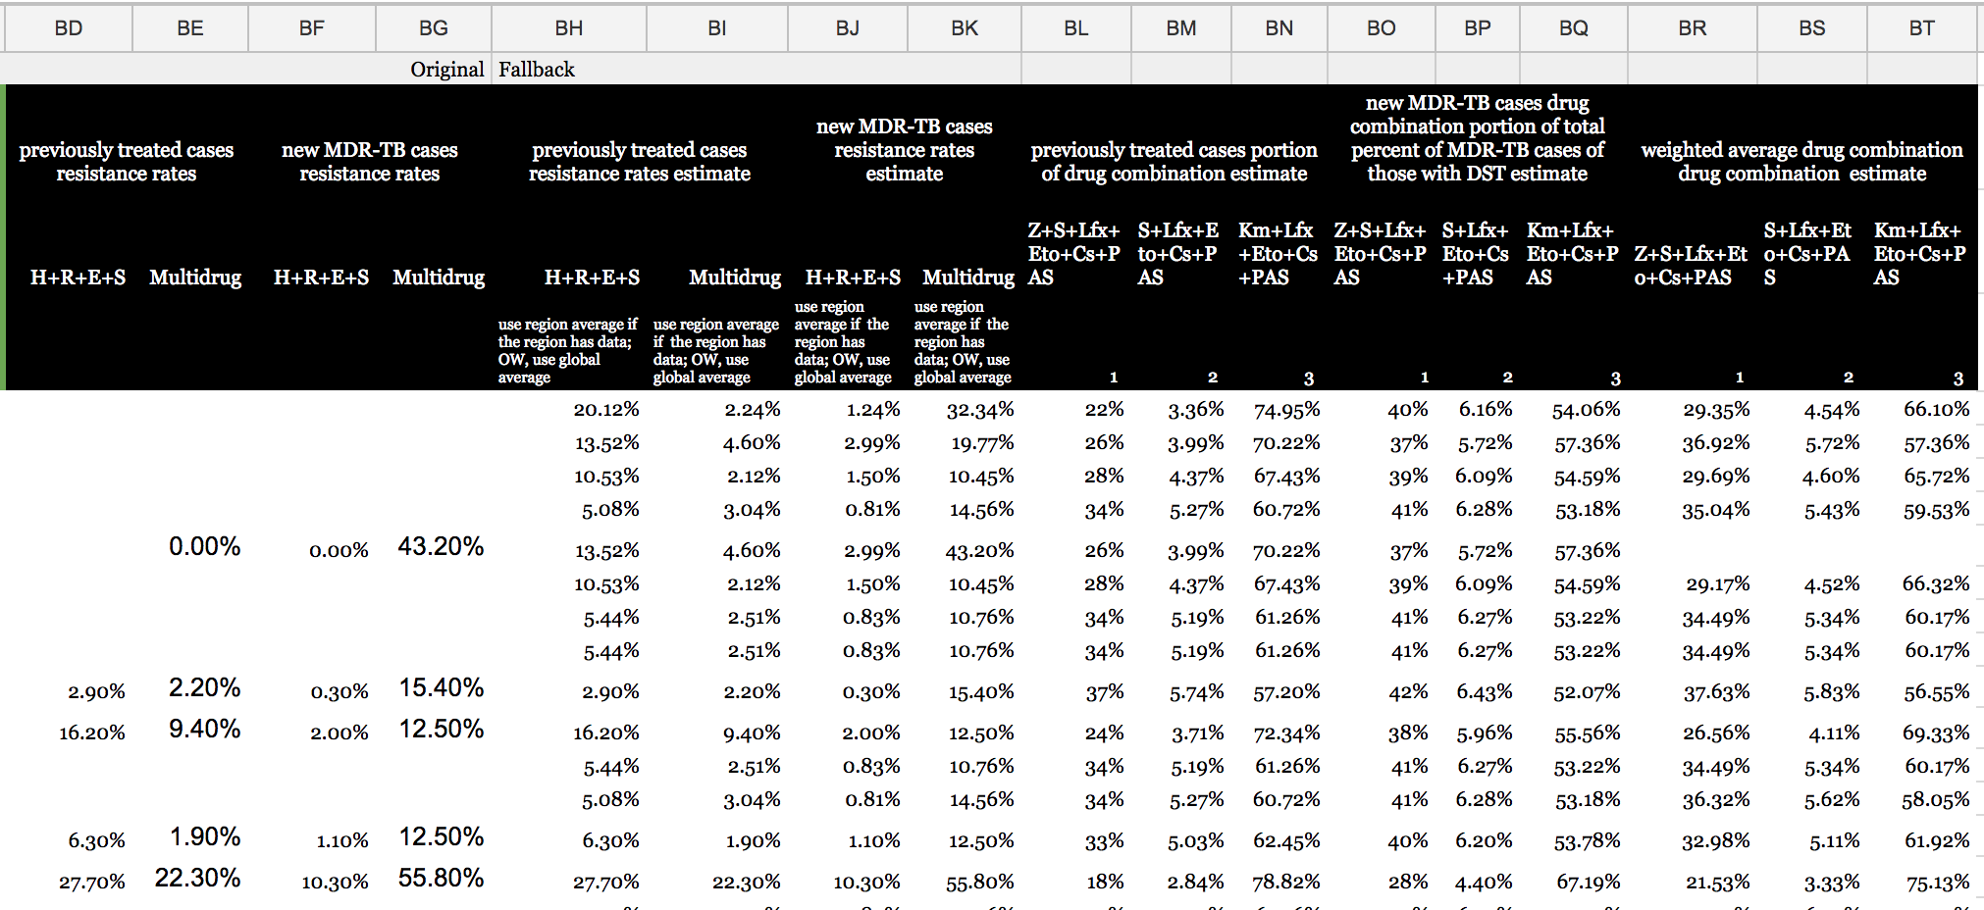
Resistance Rates
Resistance to certain drugs is what determines
the recommended treatment regimen, and can
therefore be used to estimate the proportions
of people that receive each regimen. These
calculations are initially split into either new TB
cases or retreatment cases, since there is unique
resistance rate data for both. Once each category
of MDR-TB drug resistance has a proportion calculated, the retreated and new cases are combined into the final section that determines the
proportion of all MDR-TB cases that are receiving each treatment regimen.
Range BD:BG: Hand-inputted new and retreatment data | Range BO:BQ: Newly treated MDR-TB cases with resistance to H+R+E, H+R+E+Z, and H+R+S
Range BH:BK: Applies regional and global averages | Range BR:BT: Percentage of MDR-TB cases that are either resistant to H+R+E, H+R+E+Z, or H+R+S
Range BL:BN: Previously treated MDR-TB cases with resistance to H+R+E, H+R+E+Z, and H+R+S

Slide 18
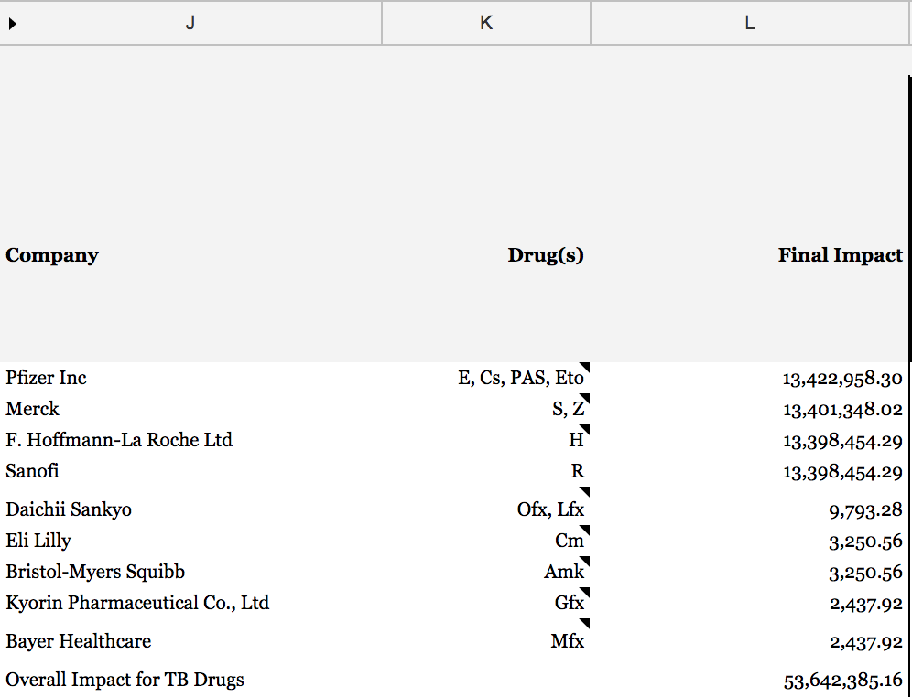
Patent Holder Rankings
Column J: Company producing TB drugs
Column K: Drugs that respective company produces
Column L: Final impact of respective company

Slide 19
Manufacturer Rankings
Our impact scores can be used to assess the performance of companies involved in the manufacturing sector of the pharmaceutical industry. Manufacturing and distribution data provided by the WHO provides important information such as cost, drug strength, and the total number of units (TNU) of each drug that are involved in shipments of a variety of medicines.
This data can be used to determine the proportion of certain classes of drugs that each manufacturer in the database is responsible for shipping.
²https://www.who.int/hiv/amds/gprm/en/

Slide 20
Manufacturer Rankings
We are able to calculate the lives saved from individual shipments of drugs so that the total number of lives saved by manufacturer can be determined. The calculation that is used is:
TNU / (365 * DD)
Where:
TNU = total number of units, or, number of pills sent in a specific order
DD = the daily dose, or the assumed average maintenance dose per day for a drug
This allows us to calculate the total lives saved due to a single drug or the total lives saved for that drug due to an individual manufacturer. We can use the proportion of total lives saved by a manufacturer to estimate the proportion of the total impact that will be attributed to that company in terms of DALYs.

Slide 21
Manufacturer Rankings
The WHO's Global Price Reporting Mechanism allows us to track 21 manufacturers of drugs that target TB. Lupin Limited is a company that manufactures four TB drugs: Ethambutol (E), Isoniazid (H), and Rifampicin, (R), and Rifampicin+Isoniazid (R+H). Let's calculate the DALYs saved by Ethambutol:
Using our formula we find that, in 2010, E alone saved a total of 53,949.89 lives. We can also see that E produced by Lupin Ltd. was calculated to have saved 7,054.26 lives. This means that Lupin Ltd.'s E contributed to 13.08% of all lives saved by E.
We also know from our previous calculations that E alleviates 13,398,454.29 DALYs globally. Therefore, we can state that E produced by Lupin Ltd. alleviates 1,751,924.28 DALYs.

Slide 22
Manufacturer Rankings
The same process can be repeated for the drugs H, R, and R+H:
H: 6,073,703.35 DALYs alleviated
R: 14,670,697.41 DALYs alleviated
R+H: 14,670,697.41 DALYs alleviated
Summing the DALYs alleviated by all four drugs yields 37,167,022.44, which can be considered Lupin Ltd.'s global impact on TB in 2010.

Slide 23
Assumptions
Efficacy of treatment for HIV+ TB | 73%
Efficacy of treatment for HIV- TB | 88%
Efficacy of MDR-TB treatment | 52%
Efficacy of XDR-TB treatment | 28%
(Estimated) % known HIV status | 46%
% of TB cases tested for HIV (with known HIV status) | 48%
% of TB cases tested for HIV that are HIV+ | 13%
% of MDR-TB that is XDR-TB | 9.60%
% global antiretroviral treatment coverage (TB/HIV+) | 70%
Proportion of new TB cases that are MDR-TB | 3.50%
Proportion of retreatment TB cases that are MDR-TB | 20.50%
XDR-TB Treatment Coverage | 57%
Drug-Susceptible-TB Treatment Coverage | 58%

Slide 24
Credit Proportions for DS-TB, MDR-TB, and XDR-TB
MDR-TB treatment regimens | Drug proportion of regimen | Proportional impact per drug
Z + S + Lfx + Eto + Cs + PAS
Z | 0.17 | 2,401.71
S | 0.17 | 2,401.71
Lfx | 0.17 | 2,401.71
Eto | 0.17 | 2,401.71
Cs | 0.17 | 2,401.71
PAS | 0.17 | 2,401.71
S + Lfx + Eto + Cs + PAS
S | 0.20 | 446.19
Lfx | 0.20 | 446.19
Eto | 0.20 | 446.19
Cs | 0.20 | 446.19
PAS | 0.20 | 446.19
Km + Lfx + Eto + Cs + PAS
Km | 0.20 | 5,376.91
Lfx | 0.20 | 5,376.91
Eto | 0.20 | 5,376.91
Cs | 0.20 | 5,376.91
PAS | 0.20 | 5,376.91
DS-TB treatment regimens | Drug proportion of regimen | Proportional impact per drug
R (Months 1 to 6) | 0.25 | 10,817,525.45
H (Months 1 to 6) | 0.25 | 10,817,525.45
E (Months 1 to 2) | 0.25 | 10,817,525.45
Z (Months 1 to 2) | 0.25 | 10,817,525.45
XDR-TB treatment regimens | Drug proportion of regimen | Proportional impact per drug
Cs | 0.33 | 18,712.60
Km, Amk, or Cm | 0.11 | 6,237.53
Lfx, Mfx, Gfx, or Ofx | 0.08 | 4,678.15

Slide 25
Example: Drug Score
Impact of pyrazinamide in an MDR-TB regimen in the Dominican Republic in 2013
Let's calculate the impact of the drug Z in the Dominican Republic (DR) in 2013. We will first retrieve DR's treatment coverage and efficacy data.
MDR-TB Treatment Coverage
11.48%
MDR-TB Efficacy
52%
DR's MDR-TB DALYs will be slightly harder to find. We need to first calculate the proportion of new and retreatment cases that have MDR-TB:
a + b
c + d
x =
a = # of new cases that have MDR-TB
b = # of retreatment cases that have MDR-TB
c = Estimated new cases (any type)
d = Estimated retreatment cases (any type)

Slide 26
Example: Drug Score
Impact of pyrazinamide in an MDR-TB regimen in the Dominican Republic in 2013
The completed formula and result can be found below:
30 + 62
454.44 + 310
x =
x = 12.03%
Now we can multiply this number by DR's DALYs, 18,000, and then subtract the DALYs lost to XDR-TB, 207.94. This gives us 1,958.06 DALYs lost to MDR-TB.

Slide 27
Example: Drug Score
Impact of pyrazinamide in an MDR-TB regimen in the Dominican Republic in 2013
Now we can calculate the impact of all MDR-TB treatment regimens. Note that we divide the impact by two because the length of MDR-TB treatment is two years.
I = / 2
1,958.06 * 11.48% * 52%
1 - 11.48% * 52%
I = 62.16
The next step will be to attribute credit amongst the three MDR-TB regimens. We can do this by multiplying the impact of all MDR-TB treatment regimens by the proportion of all MDR-TB cases that are receiving the regimen that includes Z: Z+S+Lfx+Eto+Cs+PAS (Regimen 1). To derive this proportion we need to first obtain the percentage of previously treated MDR-TB cases that use Regimen 1.

Slide 28
Example: Drug Score
Impact of pyrazinamide in an MDR-TB regimen in the Dominican Republic in 2013
According to the WHO, the estimated multidrug resistance in previously treated cases in Dominican Republic is 33.70%. The list of known drug resistance rates can be found in the table to the right.
Since the resistance rates to specific regimens do not currently add up to the 33.7% of the previously treated cases, we extend the proportion of those estimates. Since the resistance to H+R+E+S is country- or region-specific, we leave it at 3.81%. The remainder, then, adds up to 33.7%.
Drug | Previously treated rates
H+R, only | 7.1%
H+R+E | 3.3%
H+R+S | 11%
H+R+E+S | 3.81%
Drug | Adjusted rates
H+R, only | 9.92%
H+R+E | 4.61%
H+R+S | 15.36%
H+R+E+S | 3.81%

Slide 29
Example: Drug Score
Impact of pyrazinamide in an MDR-TB regimen in the Dominican Republic in 2013
We know that Regimen 1 is used when there is either resistance to H+R, only, or H+R+E. H+R+E is either administered with or without the drug Z. According to studies conducted in South Africa, the resistance to the drug Z is 42.25%. We only need to know the resistance rate for H+R+E without Z so we will do: 4.61% * (1-42.25%) to get 2.66%.
Now we can divide 9.92% by 33.7% to derive the percentage of previously treated multidrug cases that were H+R, 29.44%. The same can be done for H+R+E without Z, which comes out to 7.98%.
Let's sum these two percentages to derive the percentage of DR's previously treated population that receives Regimen 1 to treat MDR-TB: 37.33%.

Slide 30
Example: Drug Score
Impact of pyrazinamide in an MDR-TB regimen in the Dominican Republic in 2013
The same process is repeated again but with newly treated case data. The percentage of DR's newly treated population that receives Regimen 1 to treat MDR-TB is 41.66%.
The data we've collected allows us to calculate the weight of Regimen 1. In the DR, there were 30 new cases and 62 retreatment cases of MDR-TB: a total of 92 MDR-TB cases. 32.6% are new cases and 67.4% are retreatment cases. We calculate the weight of Regimen 1 as follows:
(67.4% * 37.33%) + (32.6% * 41.66%) = 38.88%

Slide 31
Example: Drug Score
Impact of pyrazinamide in an MDR-TB regimen in the Dominican Republic in 2013
To attribute credit to Regimen 1 out of all three regimens we simply need to multiply the impact of all MDR-TB regimens, 62.16, by the weight of Regimen 1, 38.88%. This gives us a final impact of 24.08 for Regimen 1, or Z+S+Lfx+Eto+Cs+PAS.
The final step is to give credit to each drug in the regimen. We assume that each drug gets equal credit, 17%. 24.08 is multiplied by 17% to get 4.09, the impact of Z in the Dominican Republic in 2013.

Slide 32
Example: Country Score
Impact of TB drugs in the Dominican Republic in 2013
The impact of all XDR-TB drugs can be easily found because we have already calculated the proportion of new and retreatment cases that have MDR-TB. We can multiply this number by DR's DALYs, 18,000, and the percentage of MDR-TB cases that are XDR-TB, 9.6%, to arrive at DR's XDR-TB DALYs: 207.94. From here we can plug DR's treatment coverage and efficacy data into the general impact formula to arrive at 39.48. We divide this number by two because the average length of XDR-TB treatment is two. Now we know that the impact of XDR-TB drugs in DR in 2013 is 19.74. Recall the impact of all MDR-TB regimens in DR in 2013: 62.16. DS-TB is calculated in a very similar way. The impacts of DS-TB HIV+ drugs and DS-TB HIV- drugs are 2,874.05 and 12,426.44, respectively.
The sum of the four types of TB is 15,382.40, the impact of TB drugs in the Dominican Republic in 2013.

Slide 33
Example: Disease Score
Impact of TB drugs in 2013
To calculate the global impact of all TB drugs in 2013 we simply apply the steps used to find the impact of TB drugs in the Dominican Republic to all remaining countries. We sum the resulting outputs to obtain 43,542,034.23, the global impact of TB drugs in 2013.

Slide 34
Example: Company Score
Impact of Merck on TB in 2013
Merck produces the drugs S and Z. The drug Z appears in one DS-TB and one MDR-TB regimen. Recall the process of calculating Z's impact in an MDR-TB regimen on the Dominican Republic. These steps should be repeated for every other country to derive Z's global MDR-TB impact: 2,535.70.
All four drugs in a DS-TB regimen are given equal credit. Divide the global impact of DS-TB HIV+ and DS-TB HIV- by four to derive Z's global DS-TB impact: 10,842,565.11.
The drug S appears in two MDR-TB regimens. Multiply the impact of MDR-TB drugs in the regimen Z + S + Lfx + Eto + Cs + PAS by 17%. Then multiply the global impact of MDR-TB drugs in the regimen S + Lfx + Eto + Cs + PAS by 20%. Sum the two resulting numbers to obtain 3,006.78: S's global MDR-TB impact.
The sum of all three numbers yields 10,848,107.59, the global impact of Merck on TB in 2013.

